Slide 1
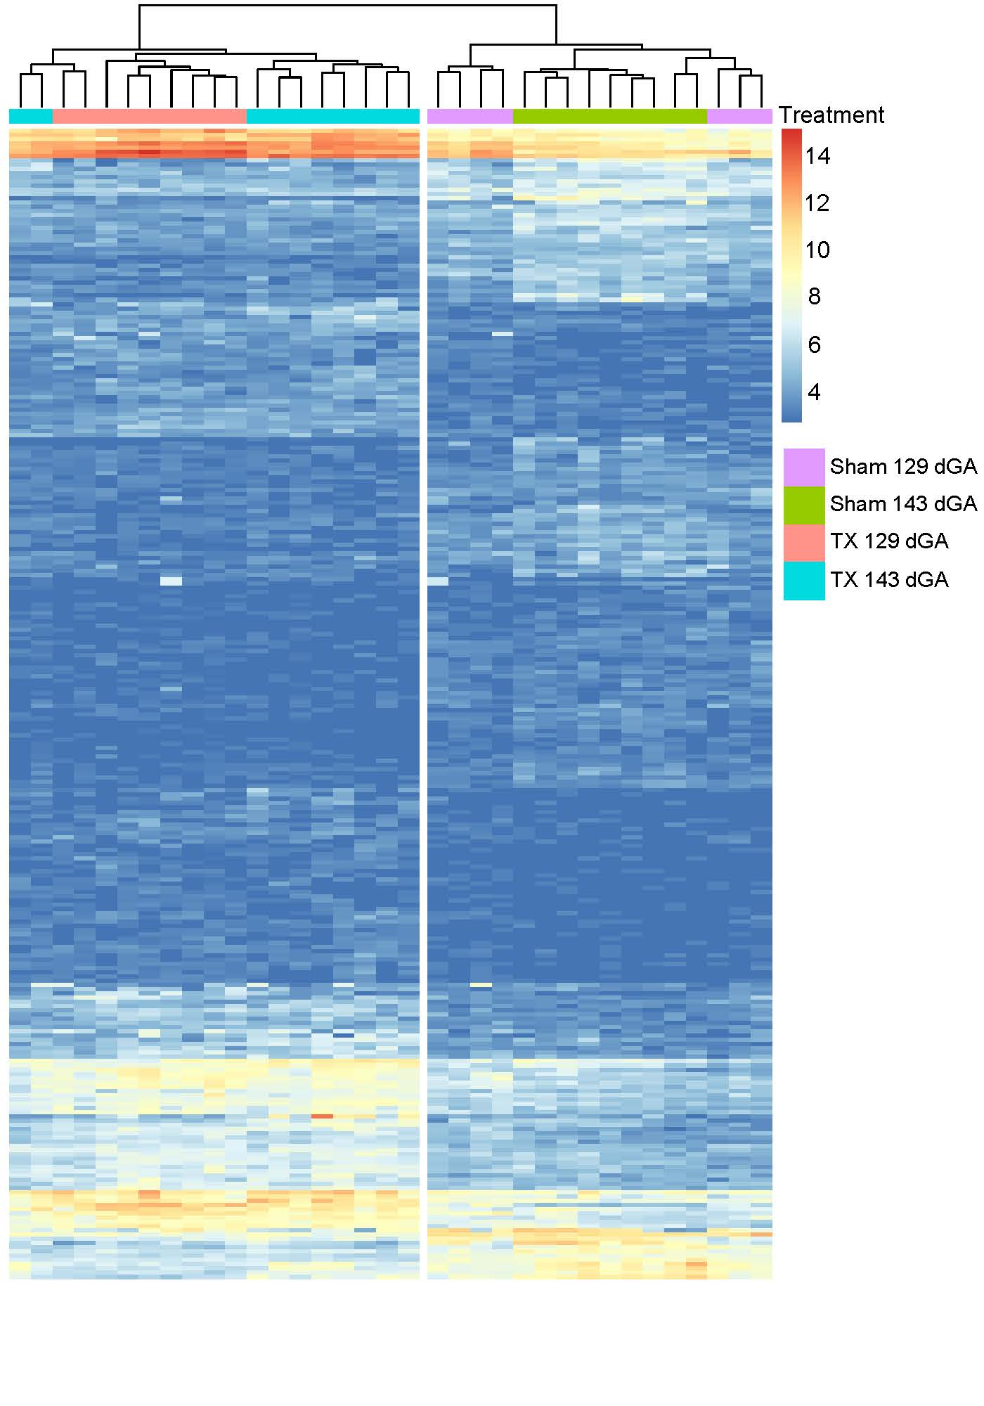
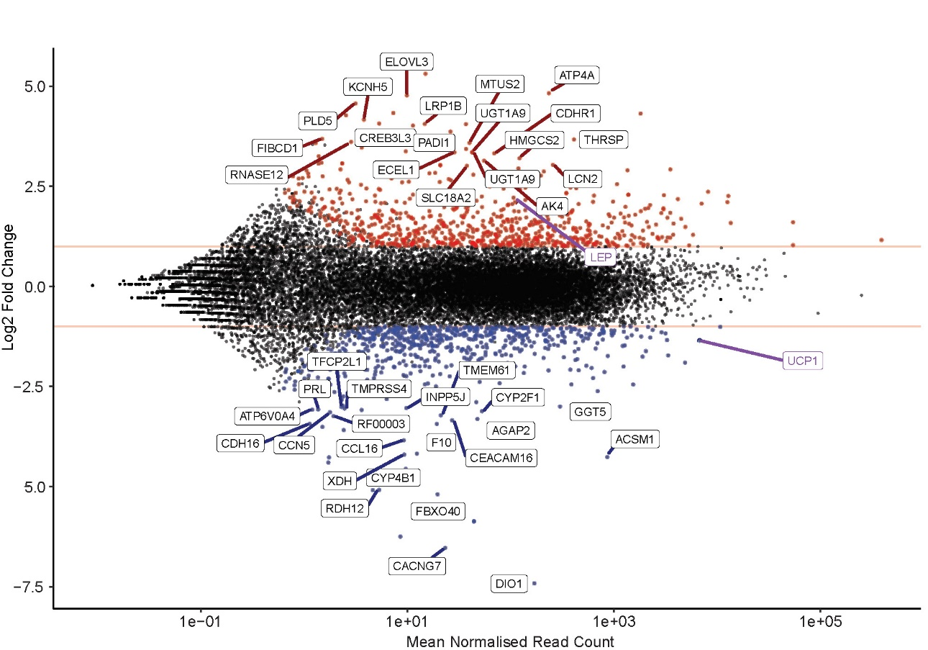
(A)
(C)
(B)
Figure S1. Principal component analysis (PCA)-based clustering plot, MA plot and heatmap plot using RNA-sequencing data from perirenal adipose tissue taken from sham and thyroidectomised (TX) fetuses at 129 and 143 days of gestation (dGA). (A) Unbiased PCA-based clustering of treatment (TX and sham) with gestational age (129 and 143 dGA). The 500 most variable genes and the two principal components were used for clustering and to describe the variance between the subsets. (B) MA plot showing differentially expressed genes for the comparison by treatment (TX and sham). Identified genes labelled with absolute log2 fold change >=3, and the key genes LEP and UCP1 indicated in purple. (C) Clustering heatmap analysis for the top 262 genes under the DESeq2 comparison by treatment with absolute log2 fold change >= 2 and Padj < 0.05.

Slide 2
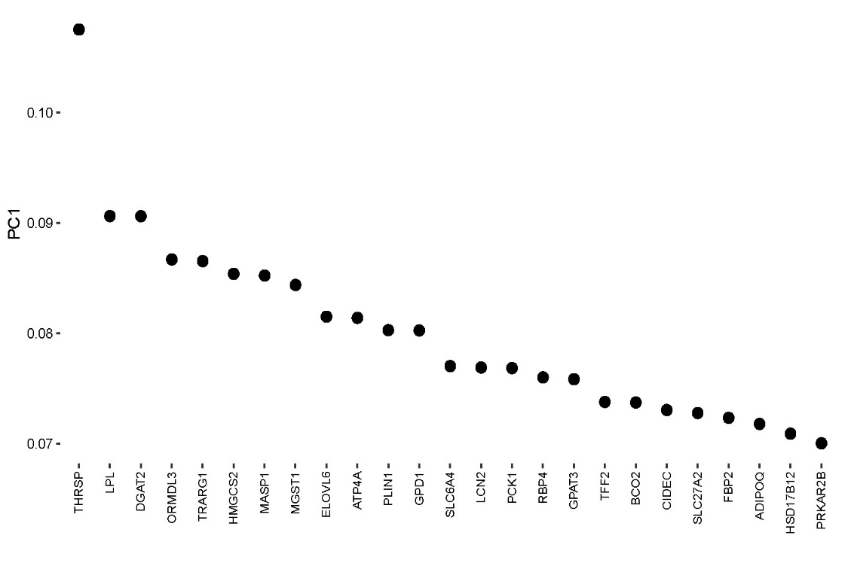
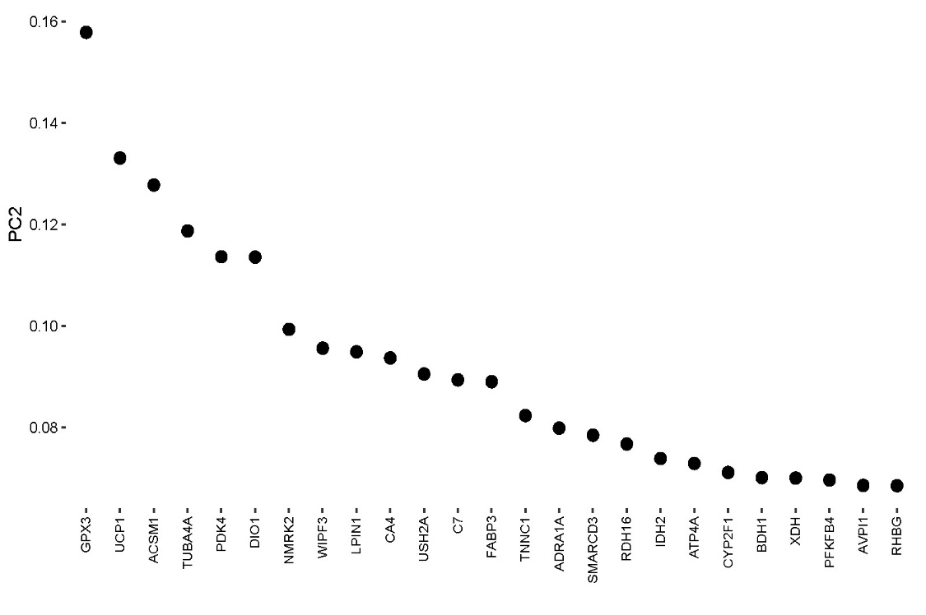
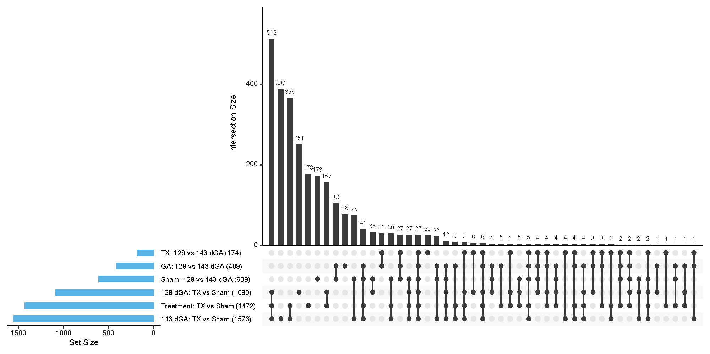
(A)
(B)
(C)
Figure S2. Principal component (PC) plots and differentially expressed gene (DEG) intersection plot using RNA-sequencing data from perirenal adipose tissue taken from sham and thyroidectomised (TX) fetuses at 129 and 143 days of gestation (dGA). (A) Top 25 genes that explain the variance by treatment (TX and sham) within PC1. (B) Top 25 genes that explain the variance by gestational age (129 and 143 dGA) within PC2. (C) Number of significant DEGs with an absolute log2 fold change >= 1, Padj < 0.05 , identified from comparisons between and within treatment and gestational age groups.
Figure 3.

Slide 3
Notes:
Figure S1. Principal component analysis (PCA)-based clustering plot, and heatmap plot using RNA-sequencing data from perirenal adipose tissue taken from Sham and thyroidectomised (TX) fetuses at 129 and 143 days of gestation (dGA). (A) Unbiased PCA-based clustering of treatment (TX and Sham) with gestational age (129 and 143 dGA). The 500 most variable genes and the two principal components were used for clustering and to describe the variance between the subsets. (B) Top 25 genes that explain the variance by treatment (TX and sham) within PC1. (C) Top 25 genes that explain the variance by gestational age (129 and 143 dGA) within PC2. (D) Hierarchical clustering heatmap analysis for the top 262 genes under the DESeq2 comparison by treatment with absolute log2 fold change >= 2 and Padj < 0.05.

Slide 4
(A)
(B)
Fig S2: Differentially expressed genes (DEG) intersection plot using RNA-sequencing data from perirenal adipose tissue taken from Sham and thyroidectomised (TX) fetuses at 129 and 143 days of gestation (dGA). (A) Number of significant DEGs with an absolute log2 fold change >= 1, Padj < 0.05 , identified from comparisons between and within treatment and gestational age groups. (B) Number of uniquely significant DEGs for each selected comparisons after all possible intersections filtering out.

